Slide 1
Syntax Analysis ( Parsing)
Lecture 7

Slide 2
The Structure of a Compiler
Lexical
analysis
Source
Tokens
Today we start
Parsing
Interm.
Language
Code
Gen.
Machine
Code
Optimization

Slide 3
Parsing Overview
What is syntax ?
  The way in which words are put together to form phrases, clauses, or sentences.
The function of a parser :
  Input: sequence of tokens from lexical analyzer
  Output: parse tree ( AST) of the program

Slide 4
Example
Pyth:
  if x == y: z =1else: z = 2
Parser input:
  IF ID == ID : ID = INT ↵ ELSE : ID = INT ↵
Parser output (abstract syntax tree):
IF-THEN-ELSE
==
=
=
ID
ID
ID
INT
ID
INT

Slide 5
Why A Tree?
Each stage of the compiler has two purposes:
  Detect and filter out some class of errors
  Translate the program representation to make things easier for later stages
Structure of tree suits the structure of language definition
With tree, later stages can easily find “the else clause”, e.g., rather than having to scan through tokens to find it.

Slide 6
Example
Java expr
  x == y ? 1 : 2
Parser input
  ID == ID ? INT : INT
Parser output
?:
INT
INT
==
ID
ID

Slide 7
Comparison with Lexical Analysis
Phase | Input | Output
Lexical Analyzer | Sequence of characters | Sequence of tokens
Parser | Sequence of tokens | Parse tree

Slide 8
Parsers
Scanners
  Task: recognize language tokens
  Implementation: DFA
    Transition based on the next character
Parsers
  Task: recognize language syntax (organization of tokens)
  Implementation:
    Top-down parsing
    Bottom-up parsing

Slide 9
The Role of the Parser
Not all sequences of tokens are programs
Parser must distinguish between valid and invalid sequences of tokens
We need
  A language for describing valid sequences of tokens
  A method for distinguishing valid from invalid sequences of tokens

Slide 10
Recursive Structure of Programming Languages
Consider the language of arithmetic expressions with integers, +, *, and ( )
An expression is either:
  an integer
  an expression followed by “+” followed by expression
  an expression followed by “*” followed by expression
  a ‘(‘ followed by an expression followed by ‘)’
int , int + int , ( int + int) * int are expressions

Slide 11
Notation for Programming Languages
An alternative notation:
  E → int
  E → E + E
  E → E * E
  E → ( E )
We can view these rules as rewrite rules
  We start with E and replace occurrences of E with some right-hand side
E → E * E → ( E ) * E → ( E + E ) * E → …
→ (int + int) * int

Slide 12
Observation
All arithmetic expressions can be obtained by a sequence of replacements
Any sequence of replacements forms a valid arithmetic expression
This means that we cannot obtain
  ( int ) )
  by any sequence of replacements. Why?
This set of rules is a context-free grammar

Slide 13
Context Free Grammars
A CFG consists of
  A set of terminals T
  A set of non-terminals N
  A start symbol S (a non-terminal)
  A set of productions P, where each rule r is of the form:
  Assuming X ∈ N
  X → ε , or
  X → Y₁ Y₂ ... Y_{n} where Y_{i} ∈ N ∪ T

Slide 14
The Language of a CFG
Read productions as replacement rules:
X → Y₁ ... Y_{n}
  Means X can be replaced by Y₁ ... Y_{n}
X → ε
  Means X can be erased (replaced with empty string)

Slide 15
Key Idea
Begin with a string consisting of the start symbol “S”
Replace any non-terminal X in the string by a right-hand side of some production
X → Y₁ … Y_{n}
Repeat (2) until there are only terminals in the string
The successive strings created in this way are called sentential forms.

Slide 16
Terminals and Non Terminals in CFG
Simple arithmetic expressions:
  E → int
  E → E + E
  E → E * E
  E → ( E )
One non-terminal: E
Several terminals: int, +, *, (, )
  Called terminals because they are never replaced

Slide 17
CFG – Learn by Example
Expr → if Expr then Expr else Expr
| while Expr do Expr
| id

Slide 18
CFG – Learn by Example
Simple arithmetic expressions:
E → E * E
| E + E
| ( E )
| id

Slide 19
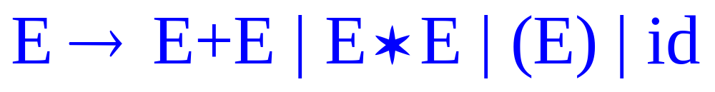
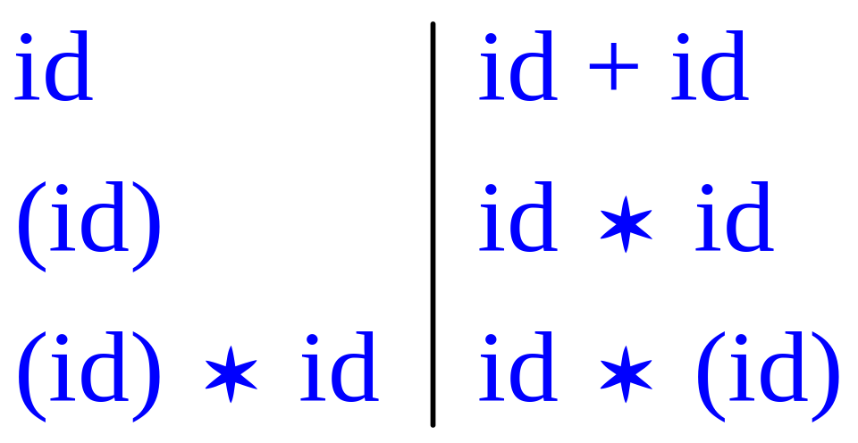
CFG – Learn by Example
Simple arithmetic expressions:
Some elements of the language:

Slide 20
Derivations and Parse Trees
A derivation is a sequence of productions
S → … → … → …
A derivation can be drawn as a tree
  Start symbol is the tree’s root
  For a production X → Y₁ … Y_{n}
  Add children Y₁ … Y_{n} to node X

Slide 21

Derivation- Learn by Example
Grammar
String

Slide 22
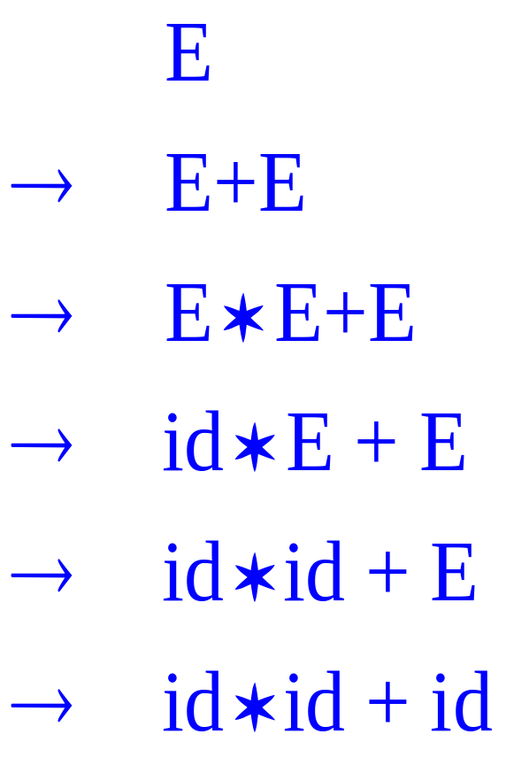
Derivation- Learn by Example
E
E
+
E
E
*
E
id
id
id

Slide 23

Derivation in Detail
E

Slide 24
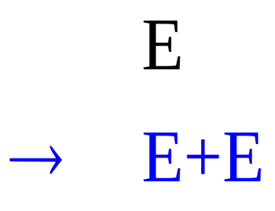
Derivation in Detail (2)
E
E
+
E

Slide 25
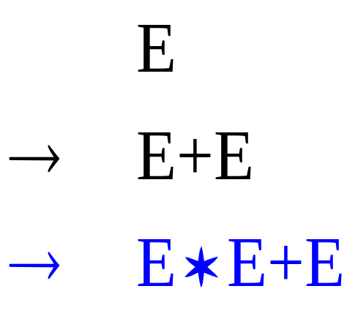
Derivation in Detail (3)
E
E
+
E
E
*
E

Slide 26
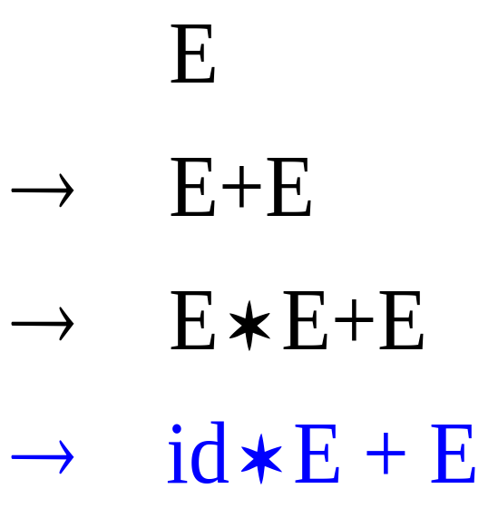
Derivation in Detail (4)
E
E
+
E
E
*
E
id

Slide 27
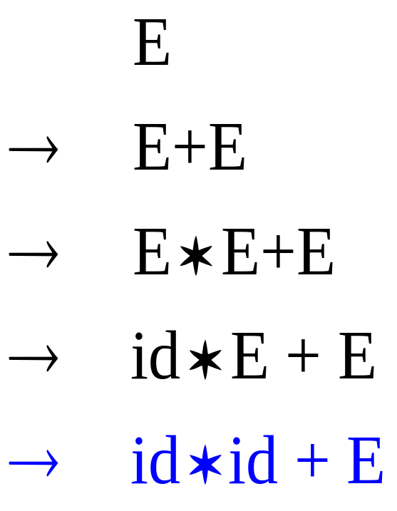
Derivation in Detail (5)
E
E
+
E
E
*
E
id
id

Slide 28
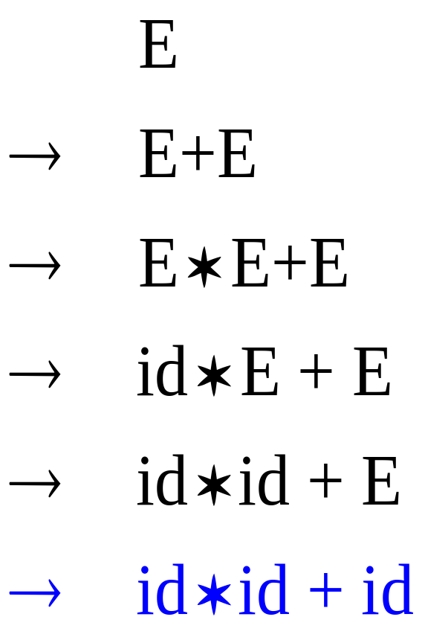
Derivation in Detail (6)
E
E
+
E
E
*
E
id
id
id

Slide 29
Points to Remember on Derivations
A parse tree has
  Terminals at the leaves
  Non-terminals at the interior nodes
An in-order traversal of the leaves is the original input.
The parse tree makes explicit the structure of the input string.

Slide 30
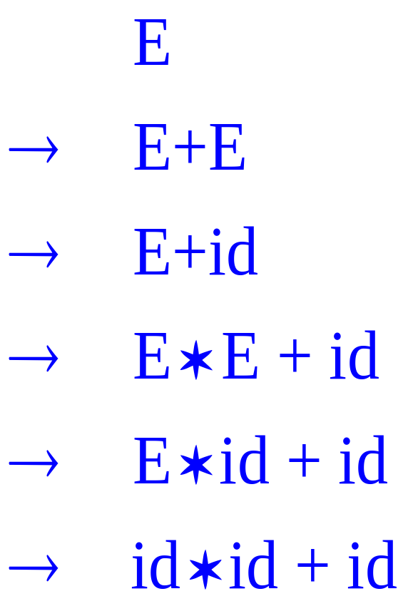
Left-most and Right-most Derivations
The example is a left-most derivation
  At each step, replace the left-most non-terminal
There is an equivalent notion of a right-most derivation

Slide 31
Difference between Derivations
Note that right-most and left-most derivations have the same parse tree
The difference is the order in which branches are added

Slide 32
Ambiguity
Grammar
  E | E + E | E * E | ( E ) | int
String
  int * int + int

Slide 33
Ambiguity (Cont.)
This string has two parse trees
E
E
E
+
E
E
*
E
E
*
E
int
int
E
+
E
int
int
int
int

Slide 34
Ambiguity (Cont.)
A grammar is ambiguous if it has more than one parse tree for some string
  Equivalently, there is more than one right-most or left-most derivation for some string
Ambiguity is bad
  Leaves meaning of some programs ill-defined
Ambiguity is common in programming languages
  Arithmetic expressions
  IF-THEN-ELSE

Slide 35
Ambiguity: The Dangling Else
Consider the grammar
  S → if E then S
  | if E then S else S
  | OTHER
This grammar is also ambiguous

Slide 36
The Dangling Else: Example
The expression has two parse trees
  if E₁ then if E₂ then S₁ else S₂
if
if
E₁
S2
E₁
if
if
E₂
_{S1}
E₂
S₁
S₂
Typically we want the second form

Slide 37
The Dangling Else: A Fix
Else matches the closest previously unmatched then
We can describe this in the grammar
S → MS /* all then are matched */
  | US /* some then are unmatched */
  MS → if E then MS else MS
  | OTHER
  US → if E then S
  | if E then MS else US
Describes the same set of strings

Slide 38
The Dangling Else: Example Revisited
The expression if E₁ then if E₂ then S₁ else S₂
if(UIF)
if(MIF)
E₁
if(MIF)
E₁
if(UIF)
S₂
E₂
S₁
S₂
E₂
S₁
A valid parse tree (for a UIF)
Not valid because the then expression is not a MIF

Slide 39
Abstract Syntax Tree. (Cont.)
Consider the grammar
  E → int | ( E ) | E + E
And the string
  5 + (2 + 3)
After lexical analysis (a list of tokens)
int₅ ‘+’ ‘(‘ int₂ ‘+’ int₃ ‘)’
During parsing we build a parse tree …

Slide 40
Example of Parse Tree
E
Traces the operation of the parser
Does capture the nesting structure
But too much info
  Parentheses
  Single-successor nodes
E
+
E
int₅
(
E
)
E
+
E
int₂
int₃

Slide 41
Syntax Analysis : A quick review
Syntax analysis, parsing
A parser for a CFG (Context-Free Grammar) is a
program which determines whether a string w is part of
the language L(G).
Function
1. Produces a parse tree if w ∈ L(G).
2. Calls semantic routines.
3. Manages syntax errors, generates error messages.
Input:
String (finite sequence of tokens)
Input is read from left to right.
Output:
Parse tree / error messages

